Slide 1
PAST CONTINUOUS
VS
SIMPLE PAST
BASIC 11 – UNIT 8b

Slide 2
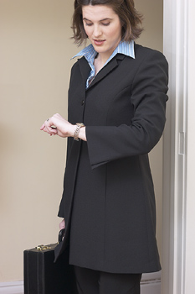
look
When I saw my teacher, she ___________ at her watch. She was late.
was looking
Notes:
Students are ready for Exercises 2 and 3 after this slide.

Slide 3
take
When I arrived, the students
__________the test.
were taking
Notes:
Students are ready for Exercises 2 and 3 after this slide.

Slide 4
sit
When the class started, he
_________ in his seat.
was sitting
Notes:
Students are ready for Exercises 2 and 3 after this slide.

Slide 5
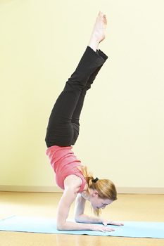
start
end
Mary went to her yoga class last night. The class _______ at 5:00 and ______ at 7:00.
started
ended
Notes:
Students are ready for Exercises 2 and 3 after this slide.

Slide 6
THE SIMPLE PAST
X
(a) Edgar ran to work yesterday.
(b) Pat drove to work this morning.
began and ended at particular
time in the past

Slide 7
THE PAST CONTINUOUS
X
X
(c) Edgar was running when the bus drove by.
(d) They were eating when I got home.
in progress
was/were + -ing

Slide 8
THE PAST CONTINUOUS
X
X
(e) When the bus drove by, Edgar was running.
(f) The bus drove by while Edgar was running.
when = at that time
while = during that time

Slide 9
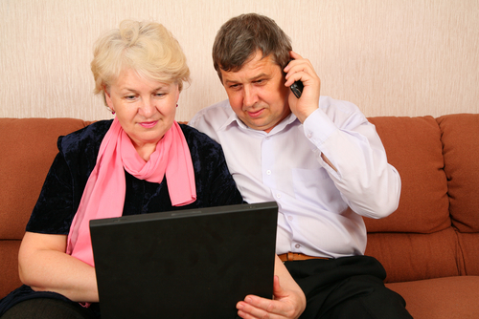
Our son called while we were using the computer.

Slide 10
(g) Mary came home I was studying.
while
(h)
When Mary came home, I was studying.
main clause + comma + time clause
time clause + comma + main clause

Slide 11
(j) She was learning to ski while he was playing golf.
two actions at the same time
past continuous okay in both

Slide 12
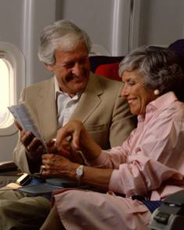
She had fun while she was flying.

Slide 13
(a) She had fun while she was flying.
(b) While she was flying, she had fun.
activity in progress
activity happened

Slide 14
2-10 Let’s Practice
attend
work
were working
While we ___________, our children
____________ school.
were attending

Slide 15
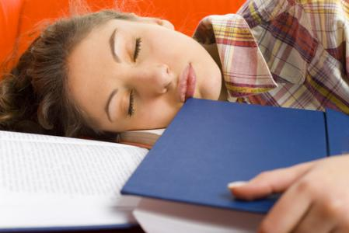
2-10 Let’s Practice
fall asleep
read
Lynn _________ while she
__________ a book.
fell asleep
was reading

Slide 16
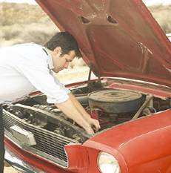
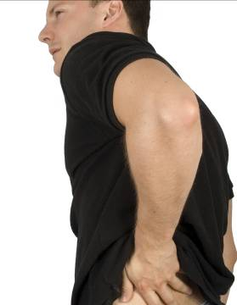
9-10 Let’s Practice
He was fixing his car.
He hurt his back.
he was fixing
While ___________ his car he _________his back.
,
hurt
Notes:
Students are ready for Exercises 2 and 3 after this slide.

Slide 17
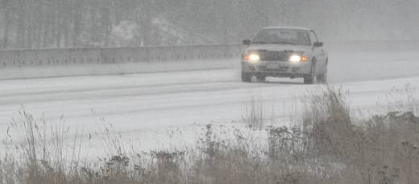
It started snowing.
I was driving to work.
I was driving to work
While ____________________, ________________.
it started snowing
Notes:
Students are ready for Exercises 2 and 3 after this slide.

Slide 18
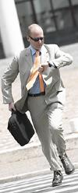
9-10 Let’s Practice
He was running to work.
He looked at his watch.
was running to work
While he _________________, ___________________.
he looked at his watch
He looked at his watch
___________________ while _______________________.
he was running to work
Notes:
Students are ready for Exercises 2 and 3 after this slide.

Slide 19
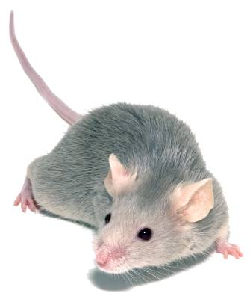
The mouse appeared while
I was studying.
I was studying when
the mouse appeared.

Slide 20
9-11 Let’s Practice
watch ring
While I ____________ the news
this morning, my cell phone ____.
was watching
rang
Notes:
Students are ready for Exercises 2 and 3 after this slide.

Slide 21
9-11 Let’s Practice
watch ring
When my phone ____,
I ___________ TV.
rang
was watching
Notes:
Students are ready for Exercises 2 and 3 after this slide.

Slide 22
meet live
When I ___ my wife, I
________ in Berlin.
met
was living
Notes:
Students are ready for Exercises 2 and 3 after this slide.

Slide 23

Kyung emailed me
last week.
I was studying when
Kyung emailed me.

